Slide 2
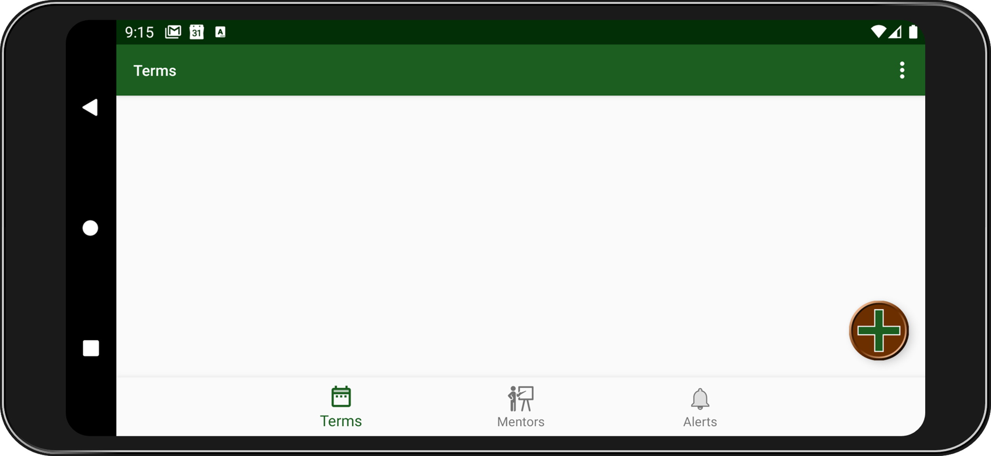
Root Activity Menus
Options Menu
Bottom Navigation

Slide 3
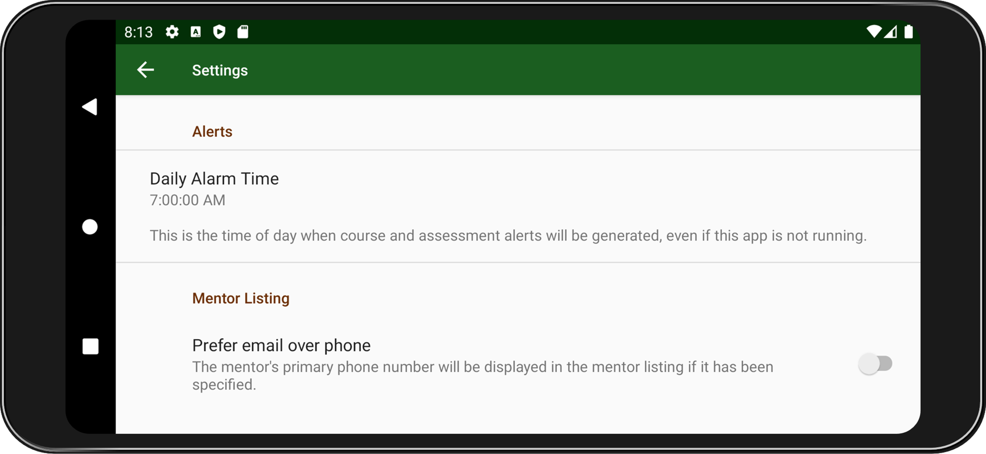
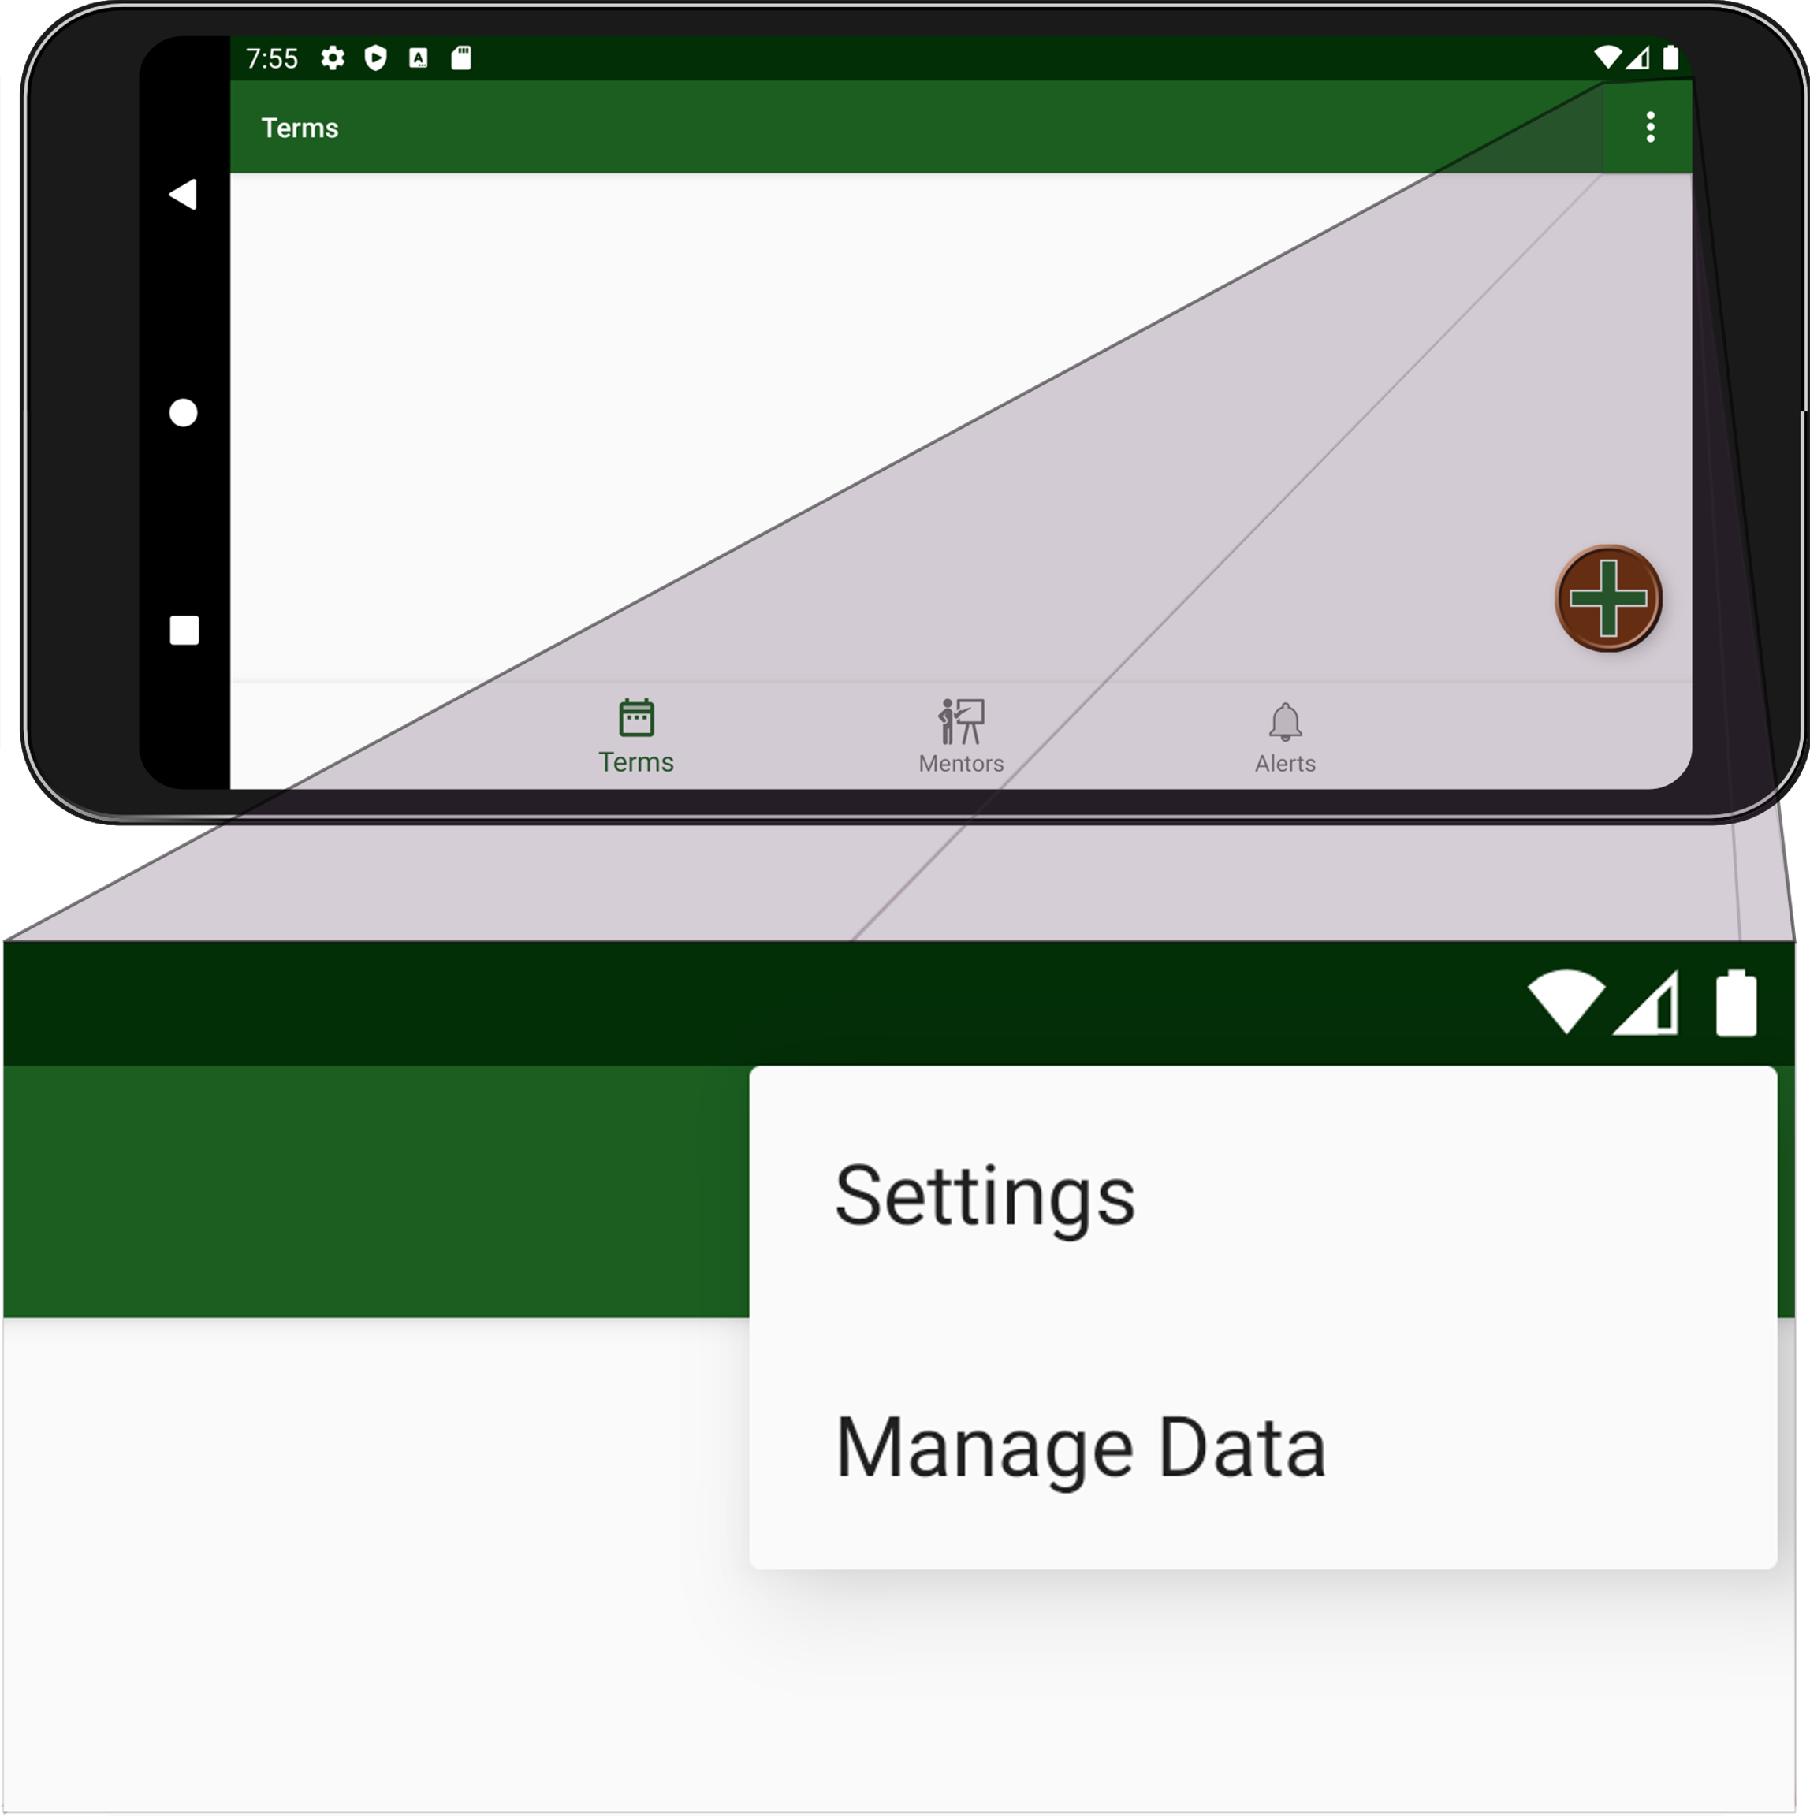
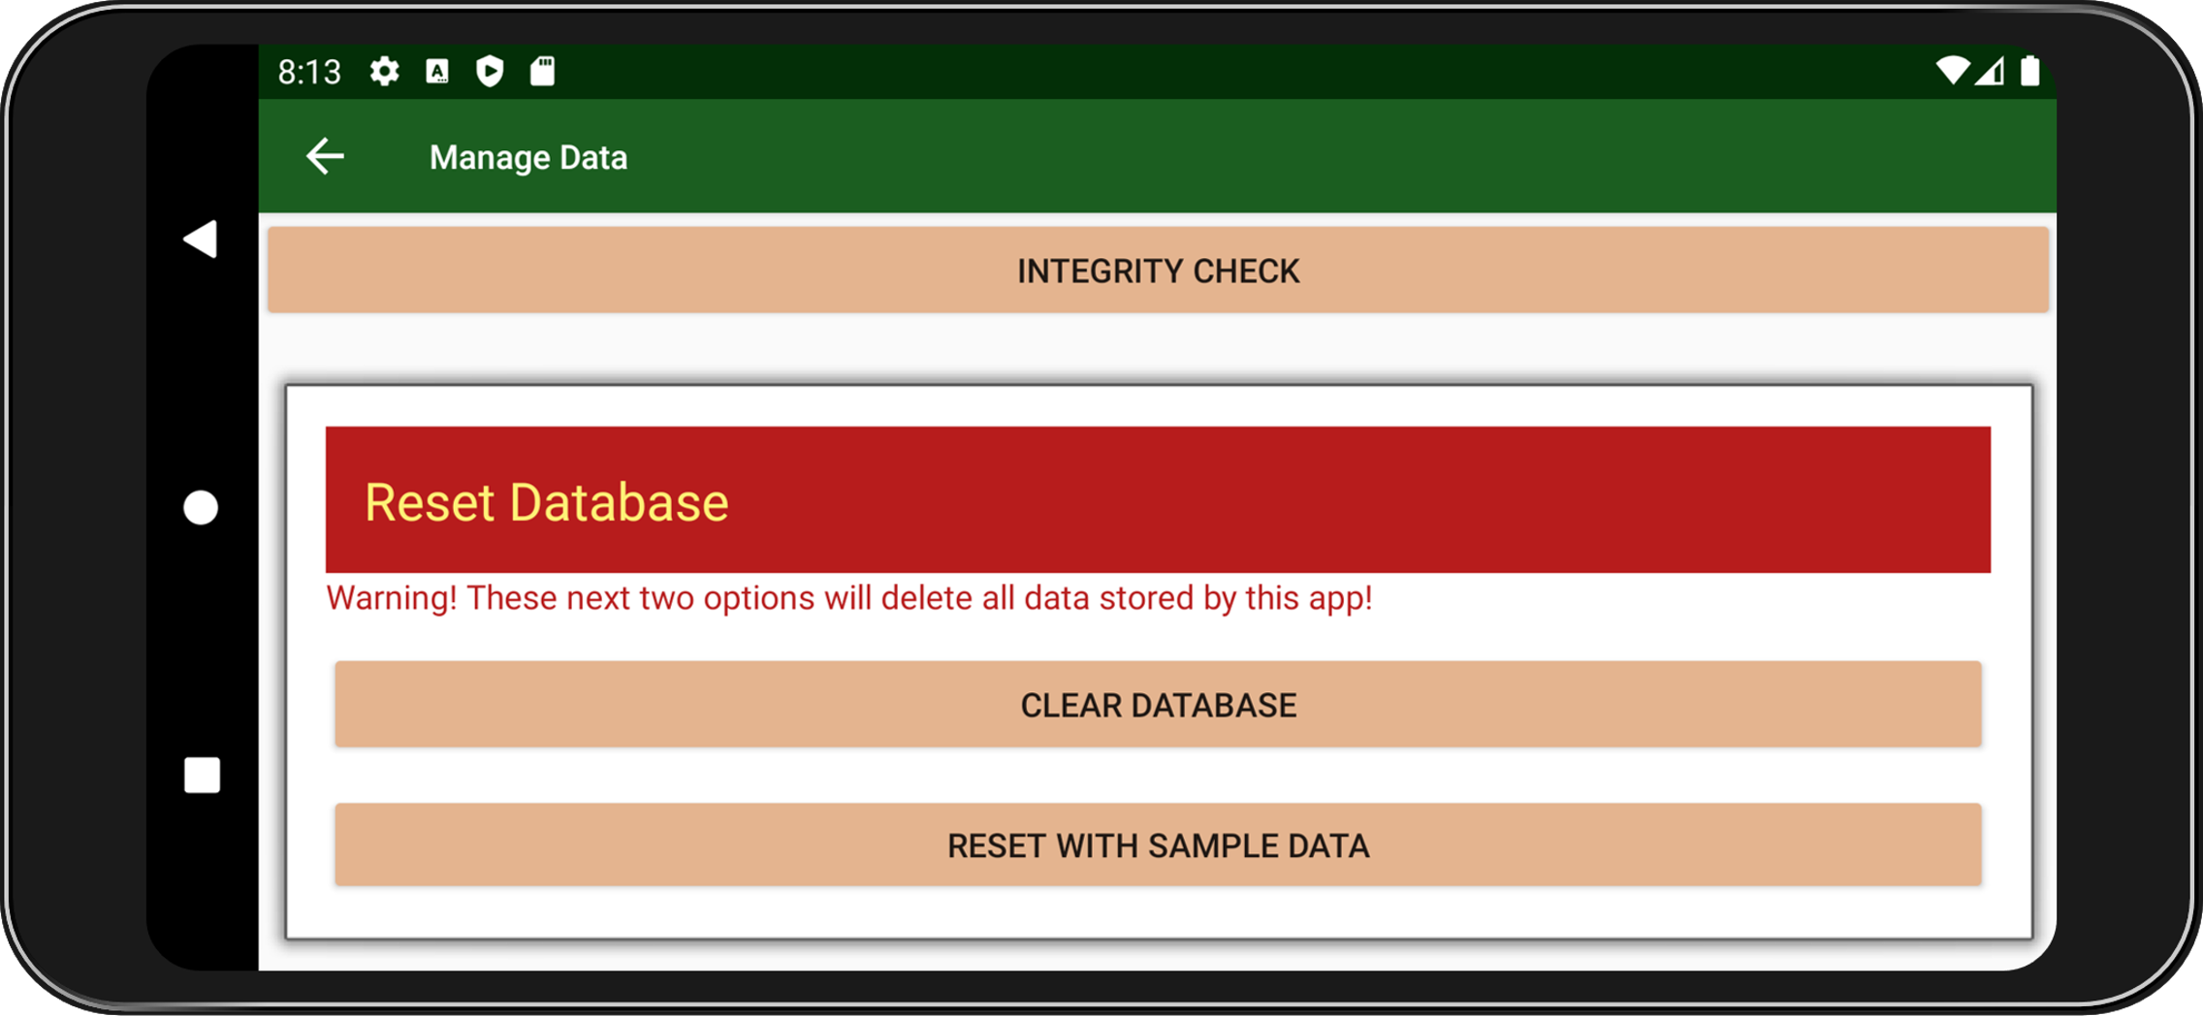
Options Menu
Root Activity
Settings Activity
Manage Data Activity

Slide 4

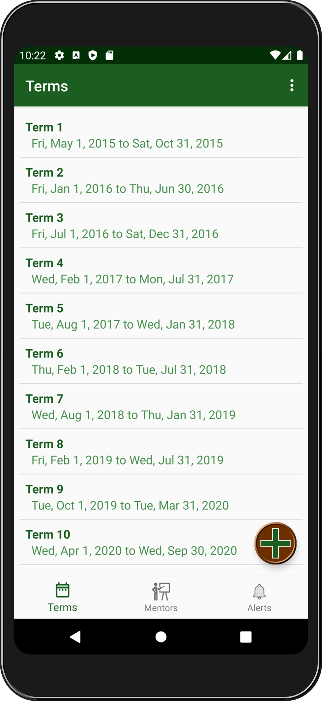

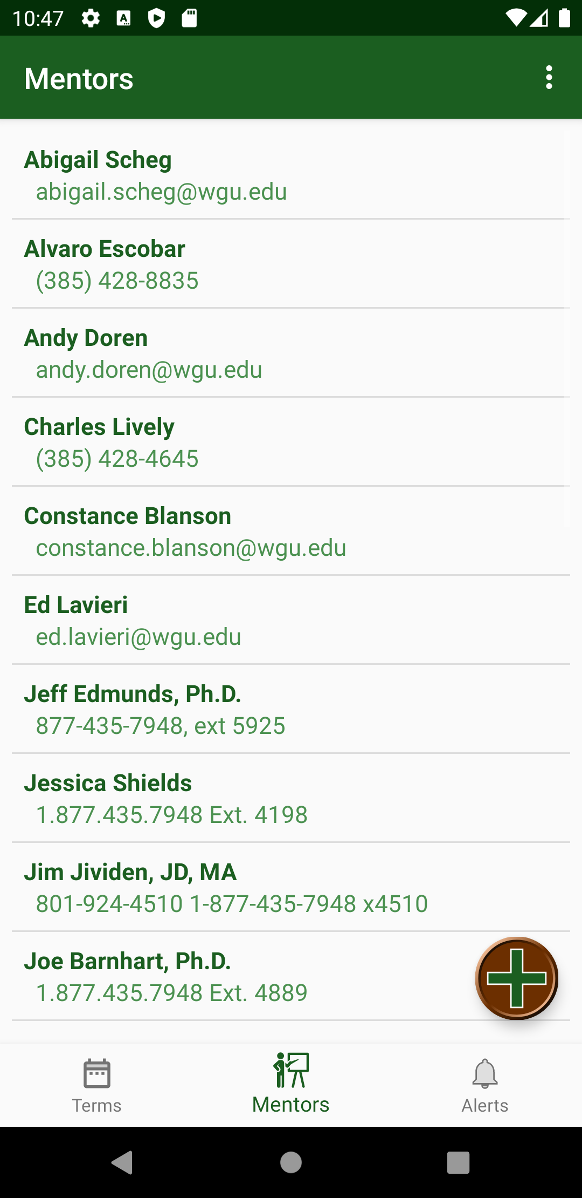
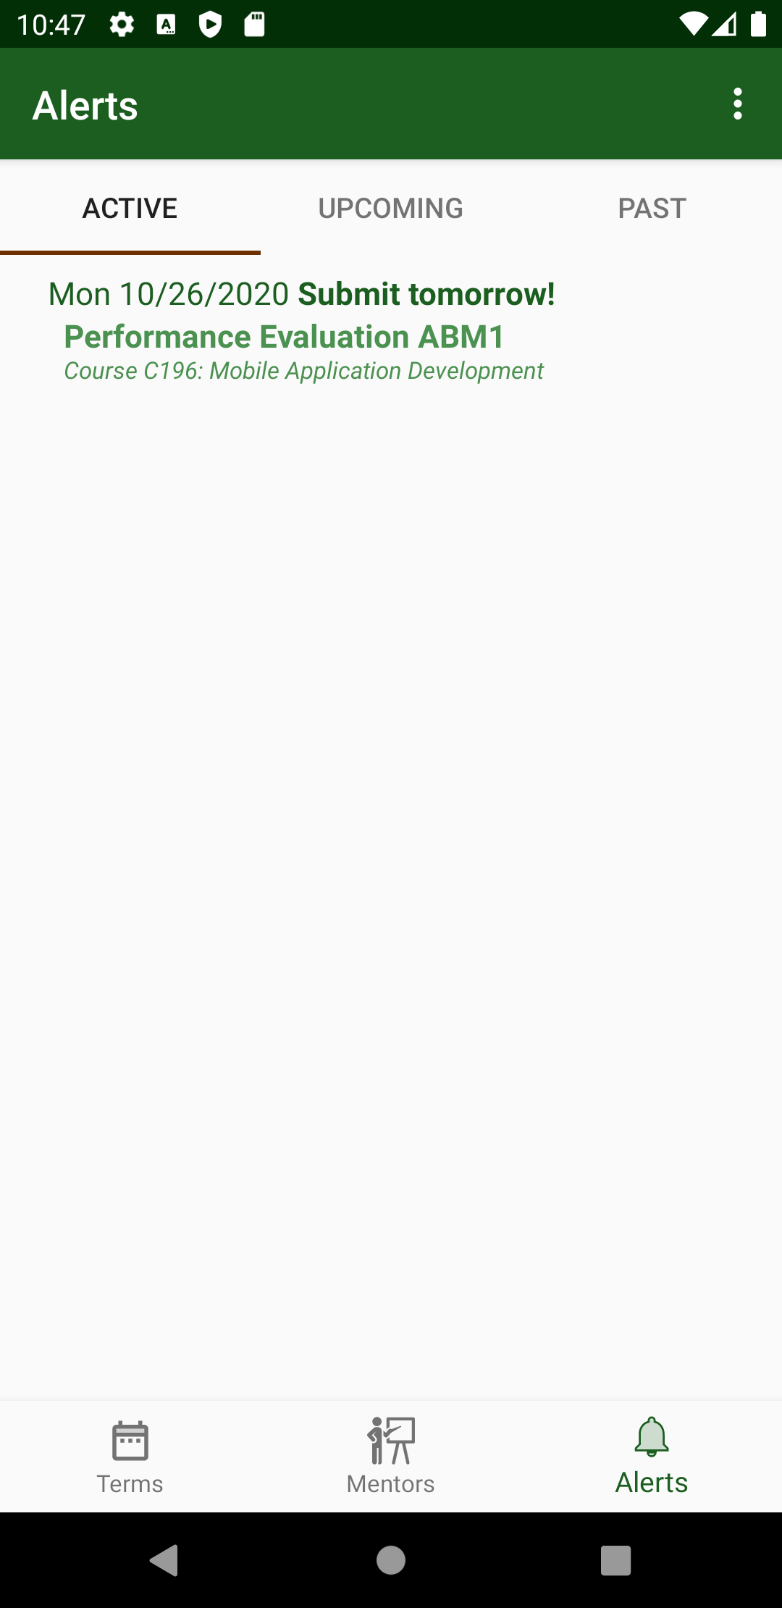
Bottom Navigation
Root Activity

Slide 5
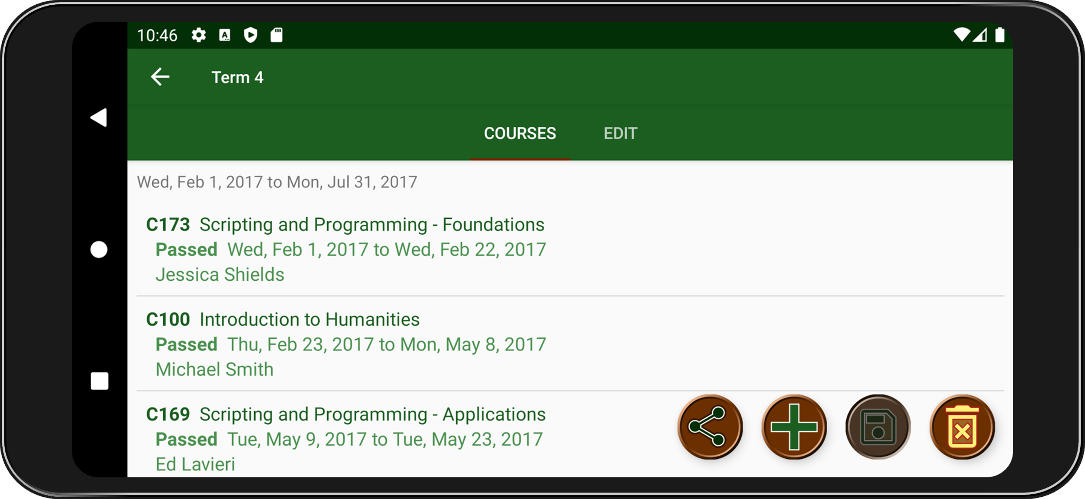
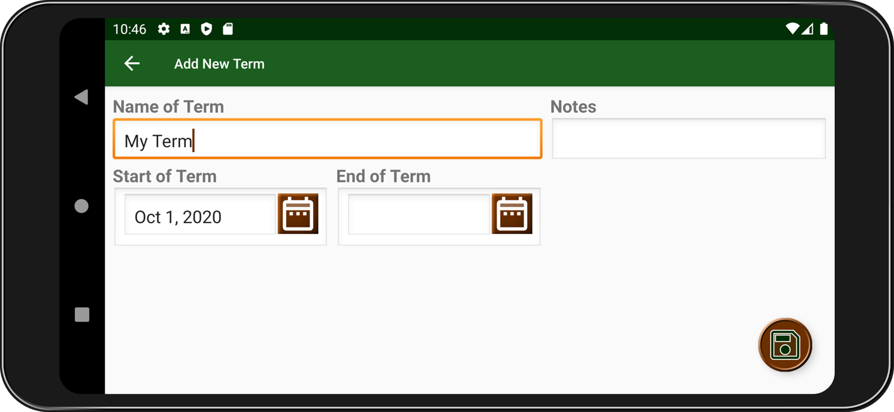
Term Listing
Root Activity
View Term Activity
View Terms
View Terms
View Term
Add New Term
Add Term Activity

Slide 6
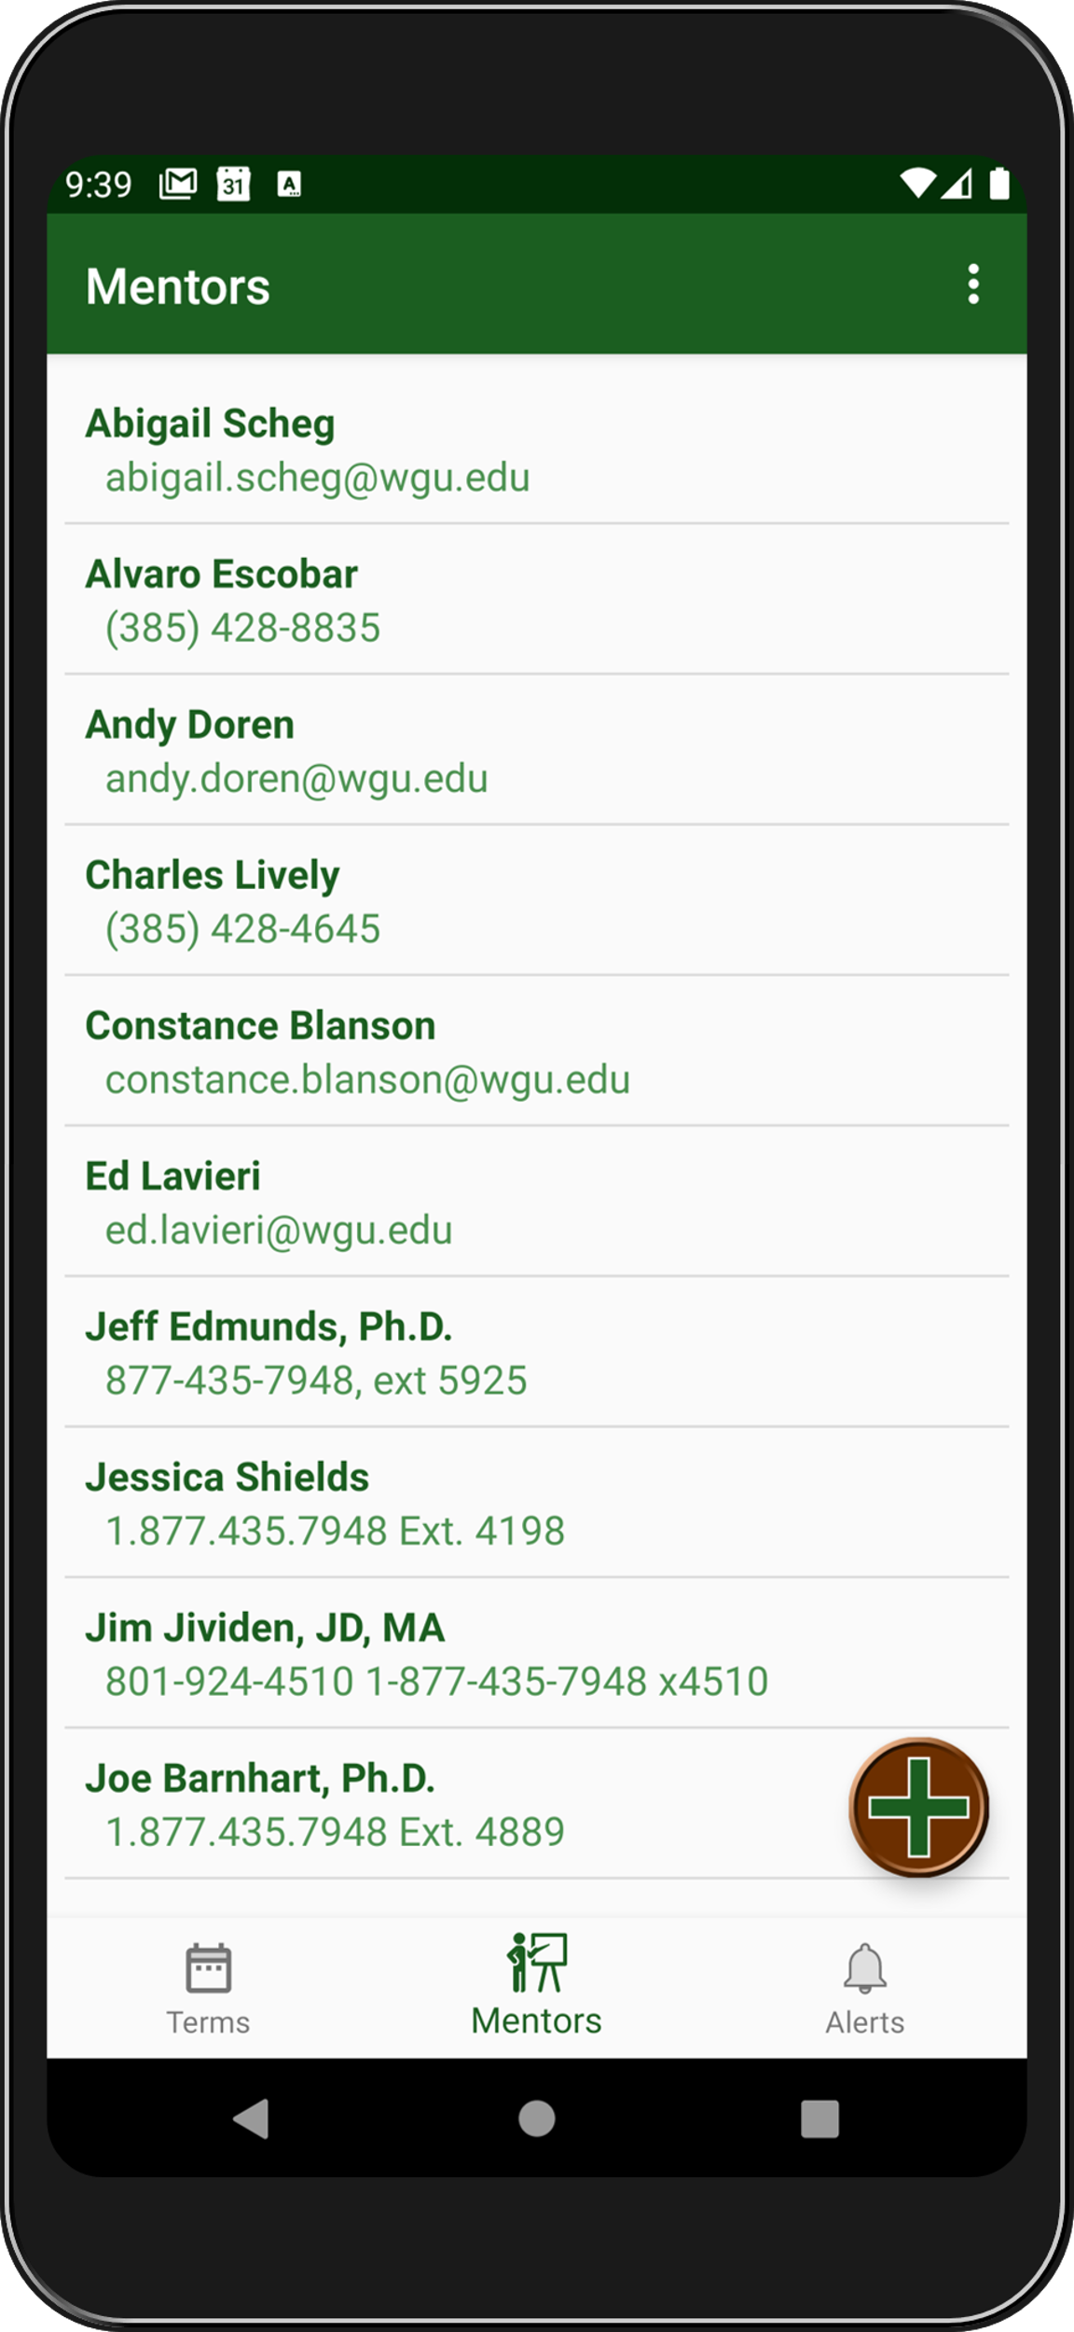
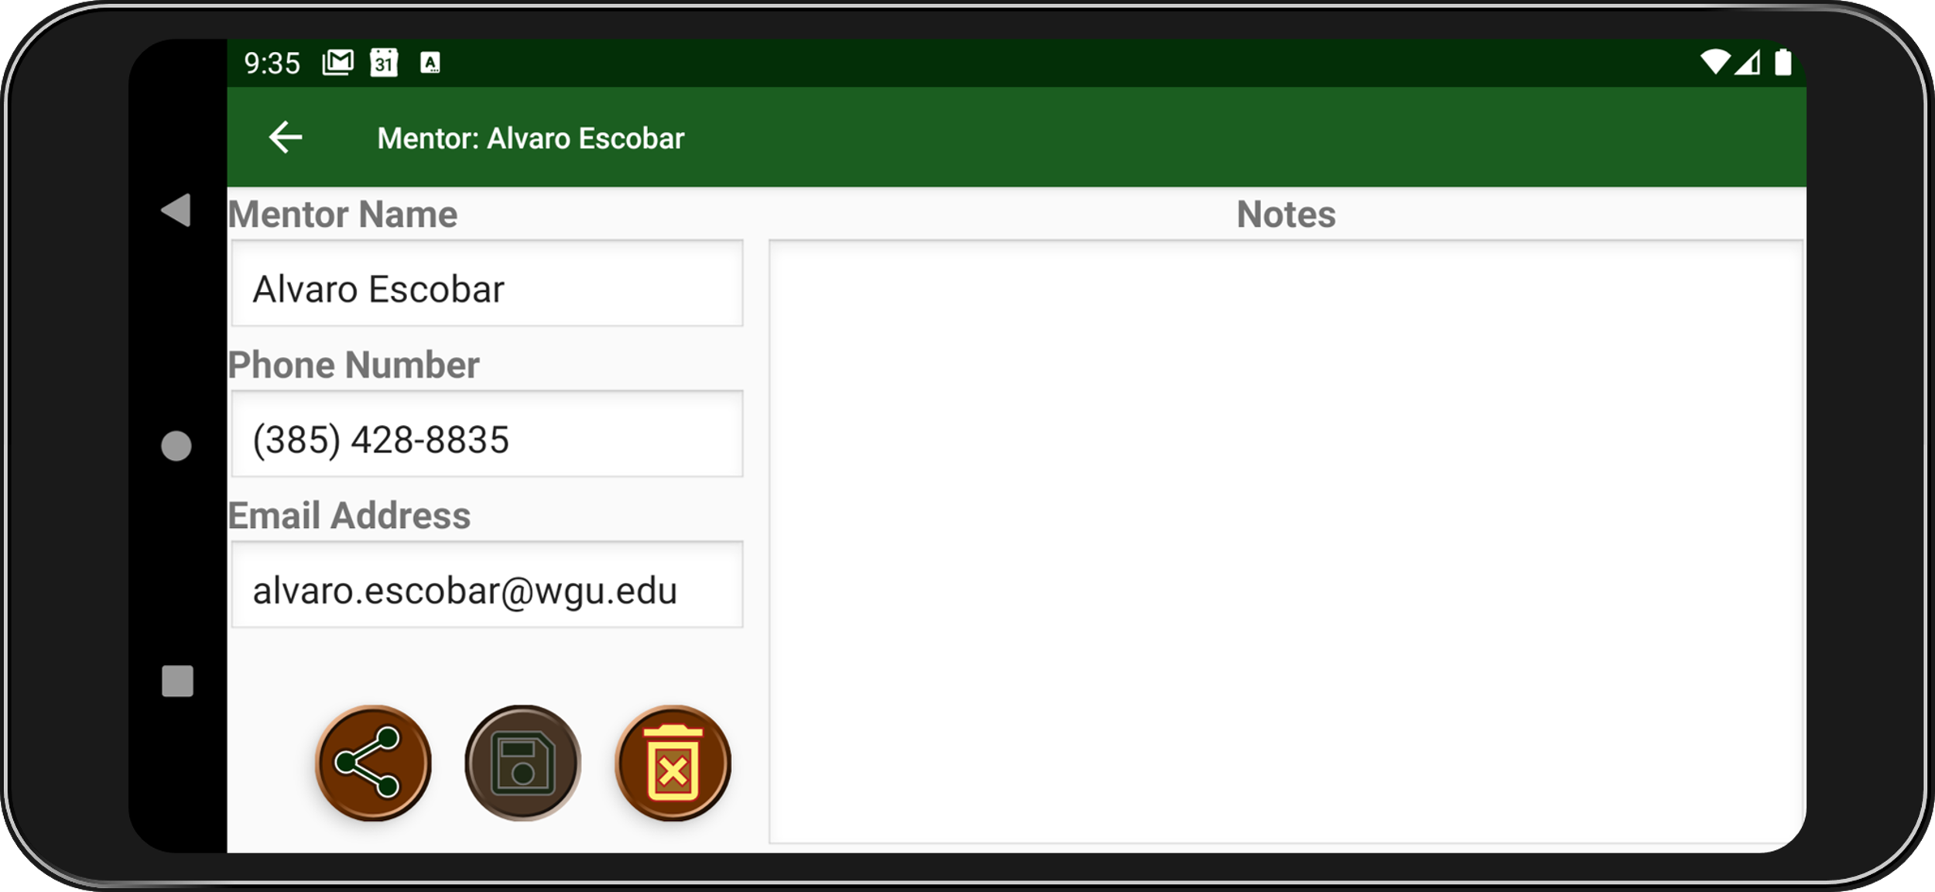
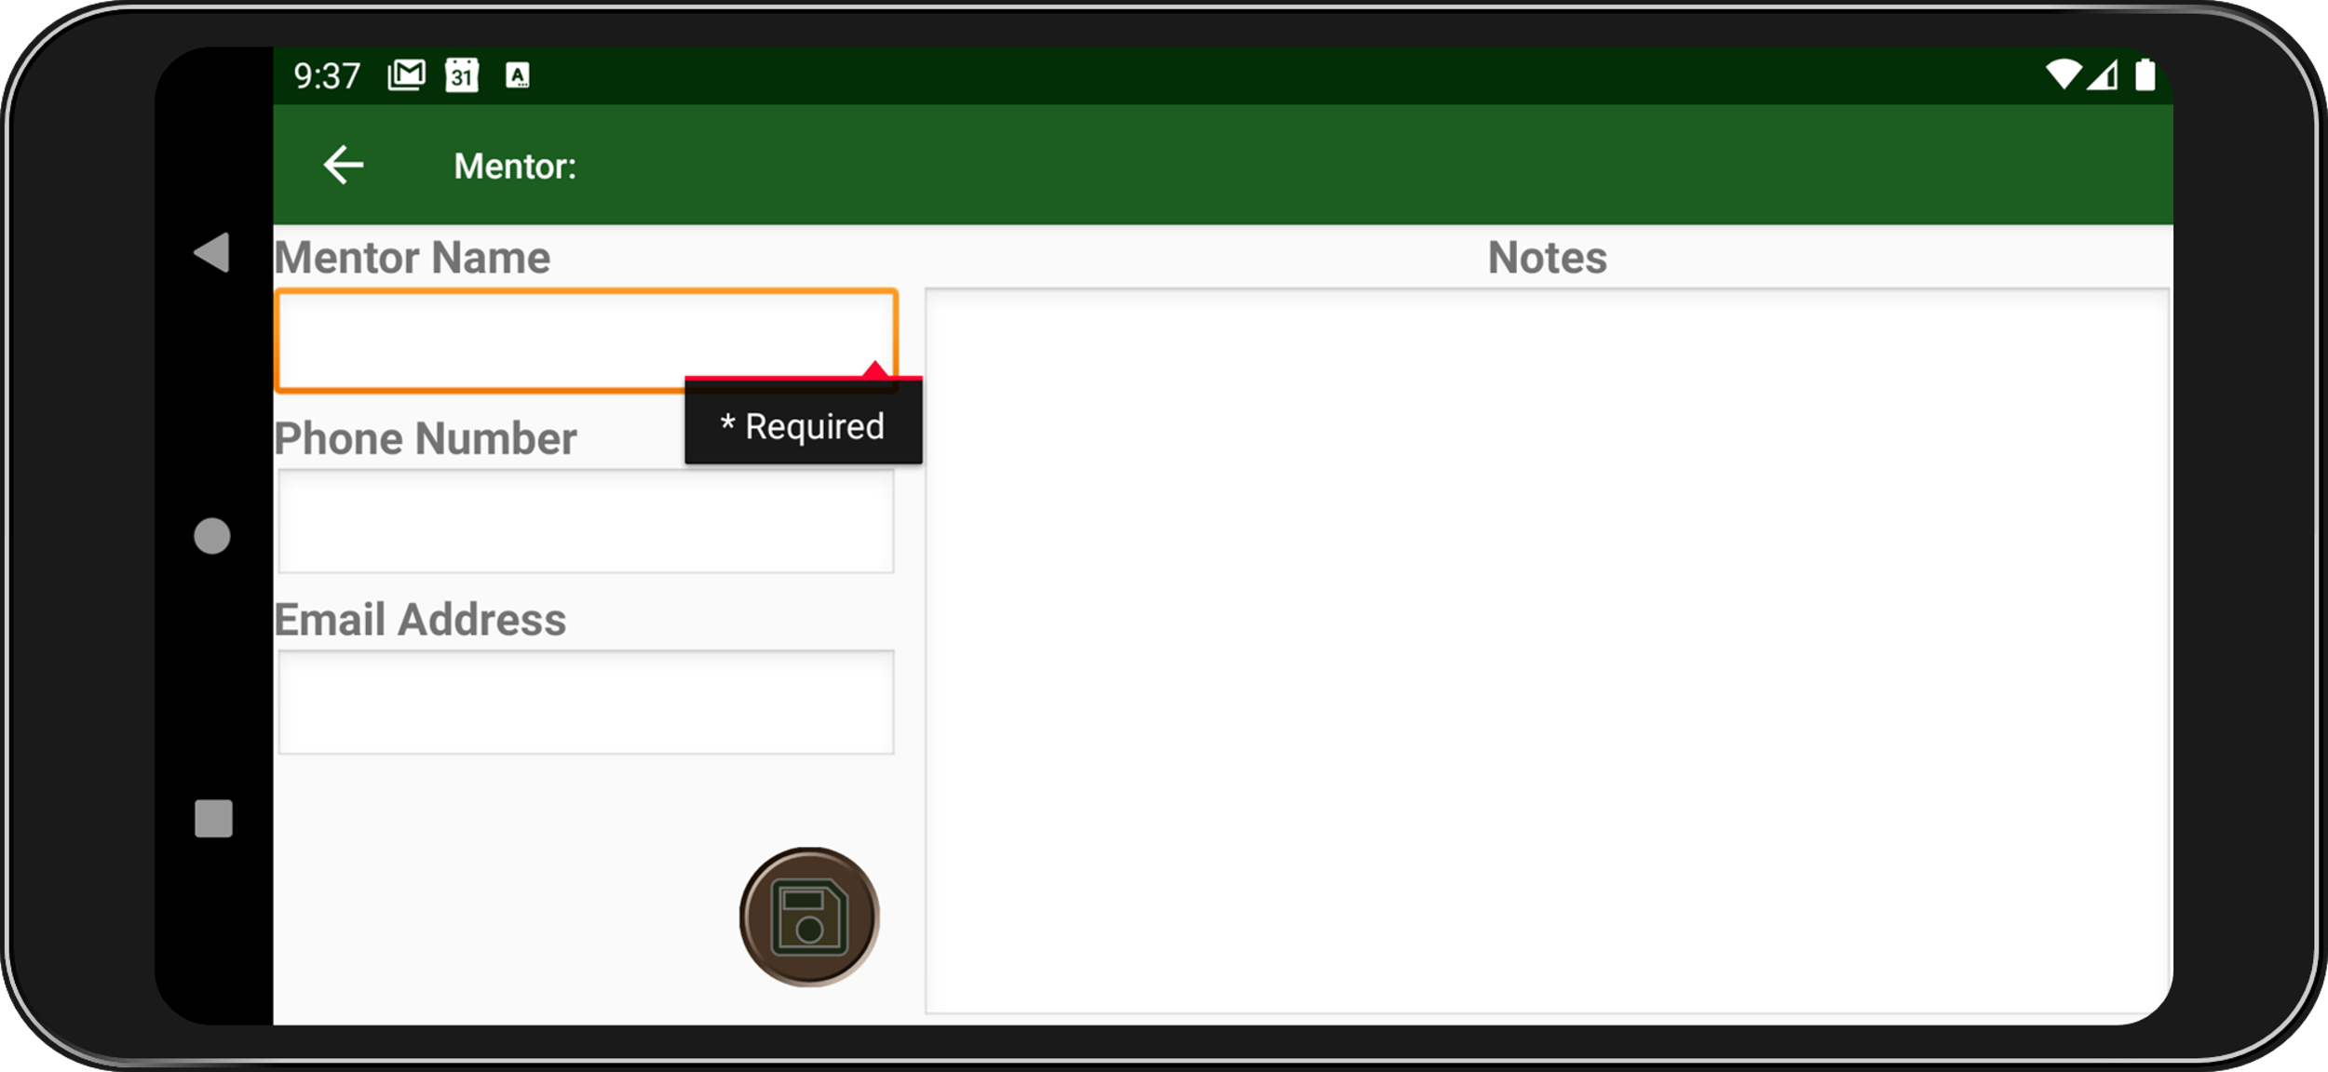
Mentor Listing
Root Activity
Edit Mentor Activity
View Terms
View Terms
Edit Mentor
Add New Mentor
Add Mentor Activity

Slide 7
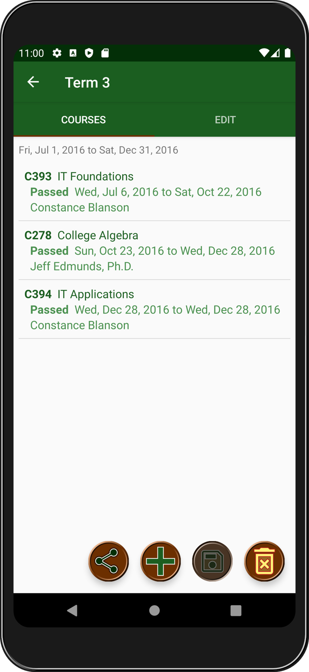
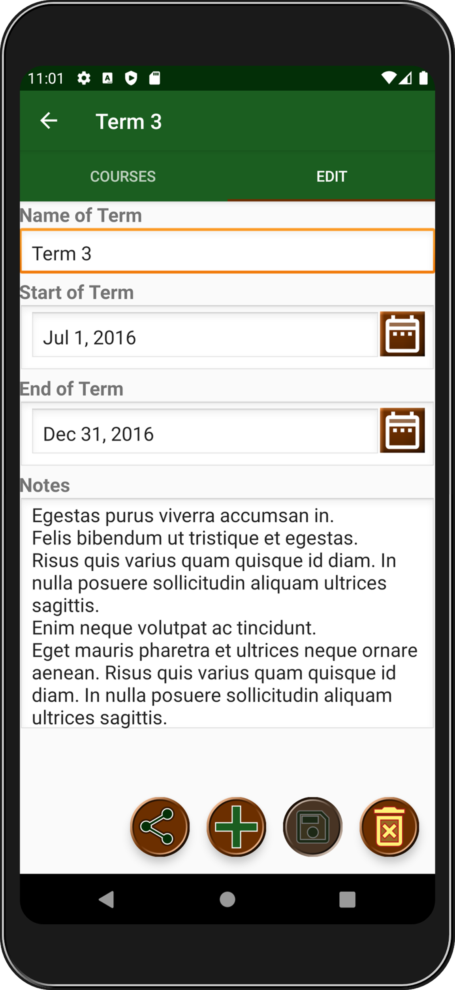


Swipe right to edit term
View Term
Activity
Swipe left for course list

Slide 8
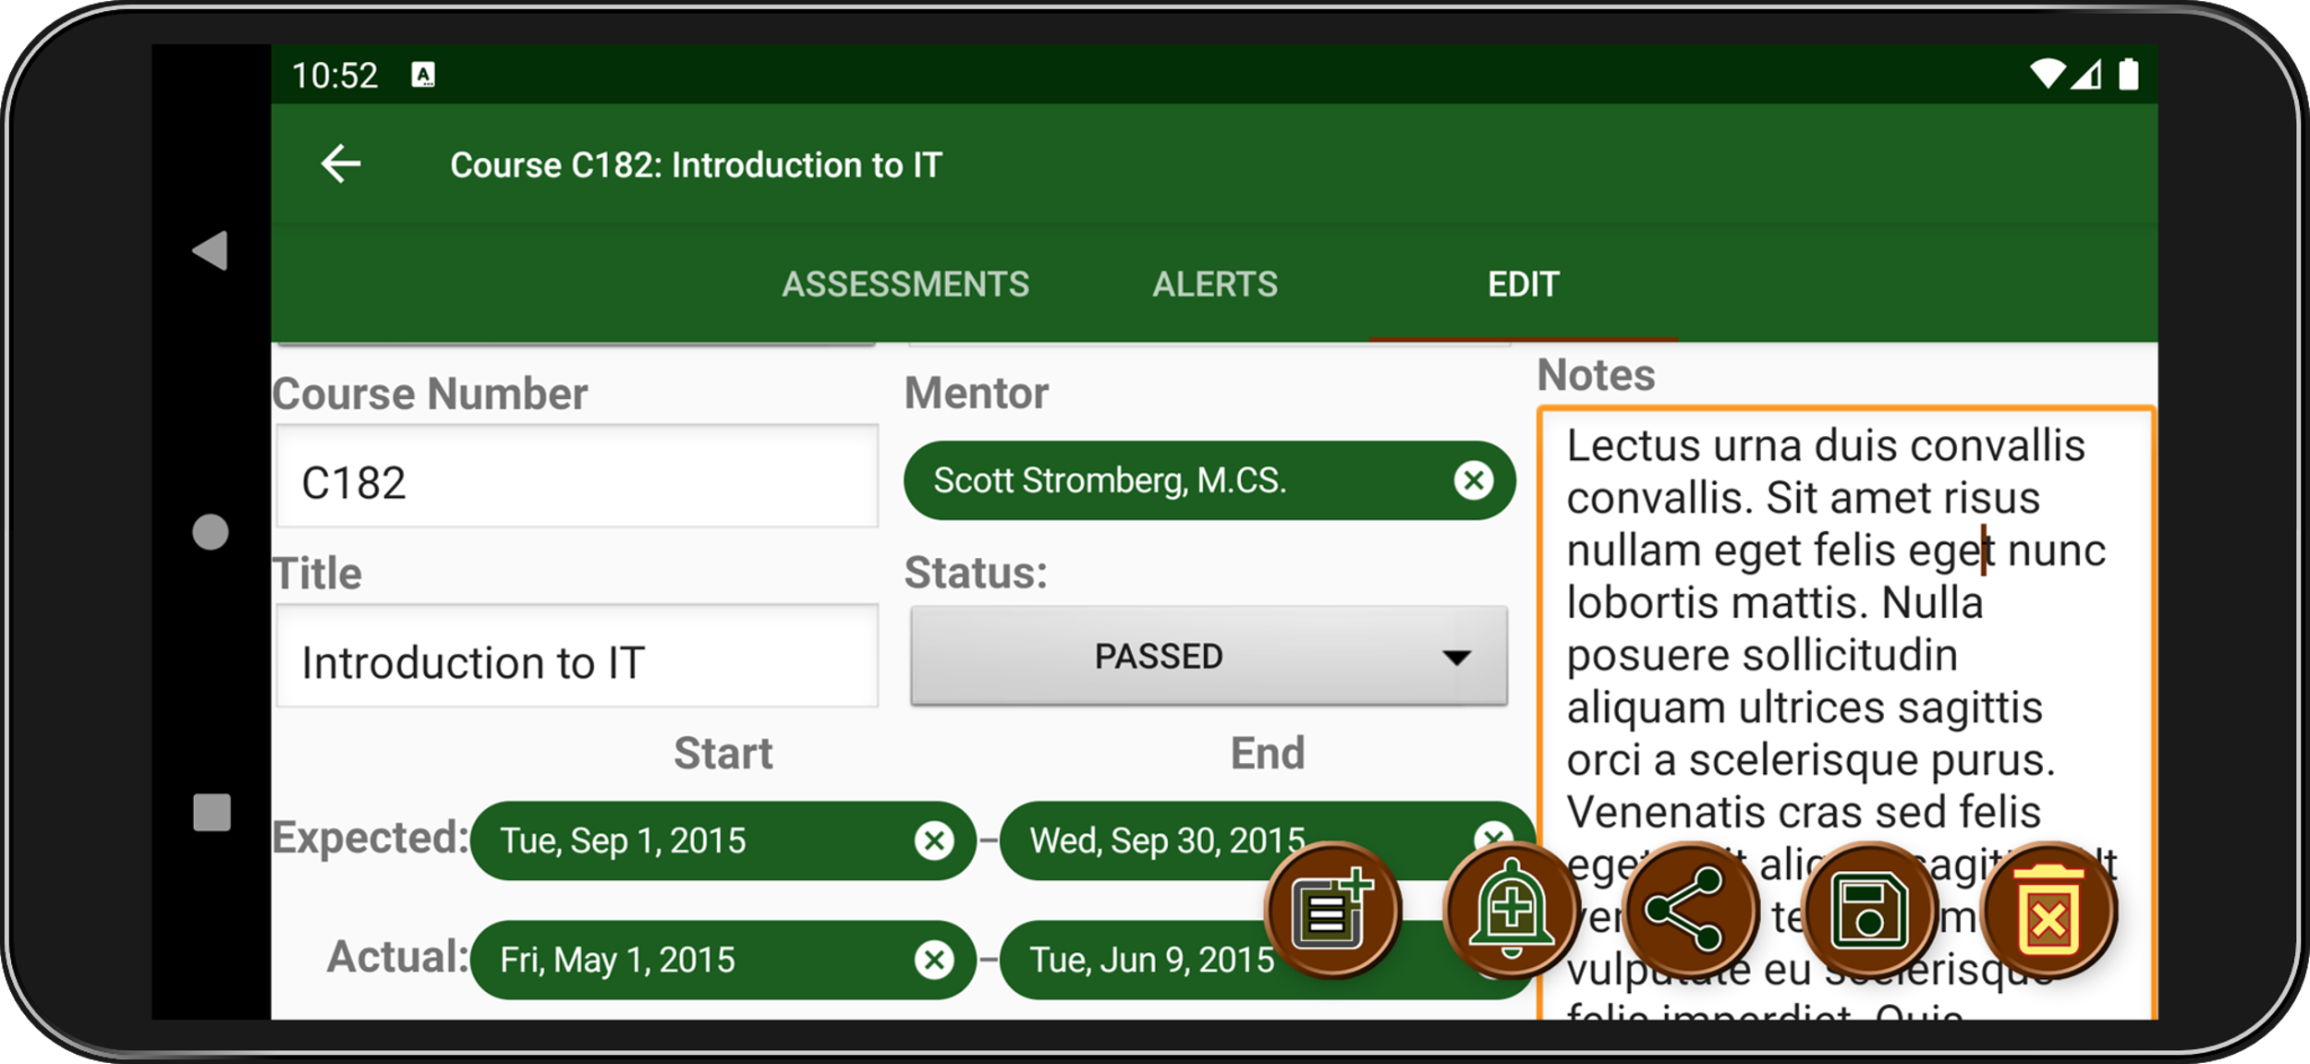

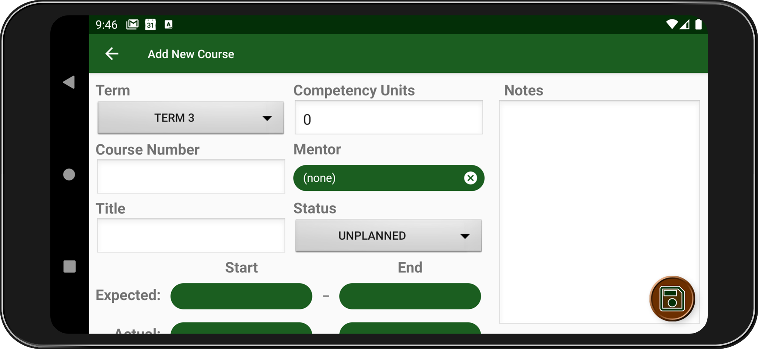
View Terms
View Course
View Term Activity
View Terms
Add New Course
View Course Activity
Save Changes
Delete Term
Add Course Activity
Share Term Info

Slide 9
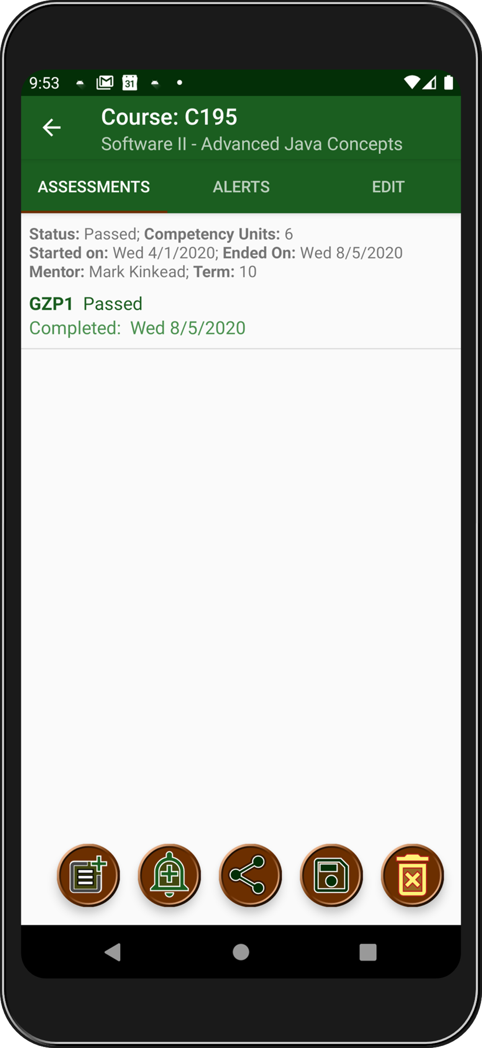
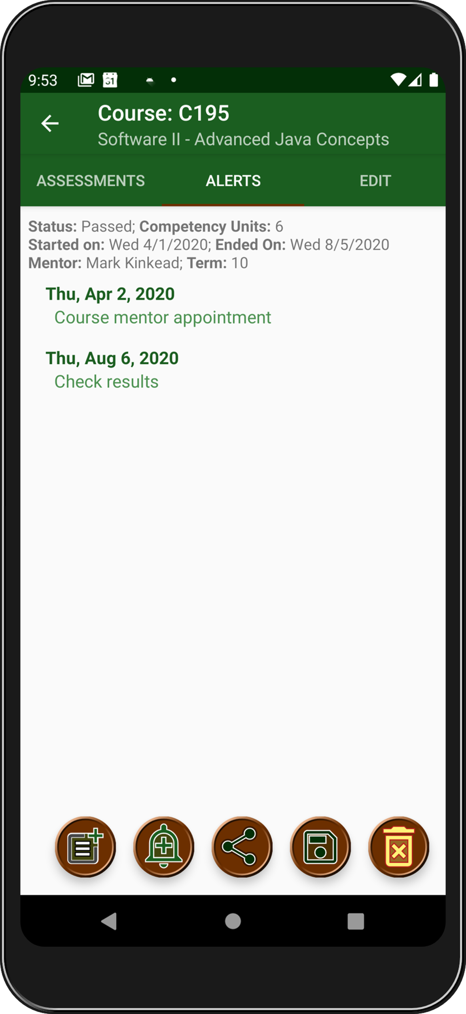
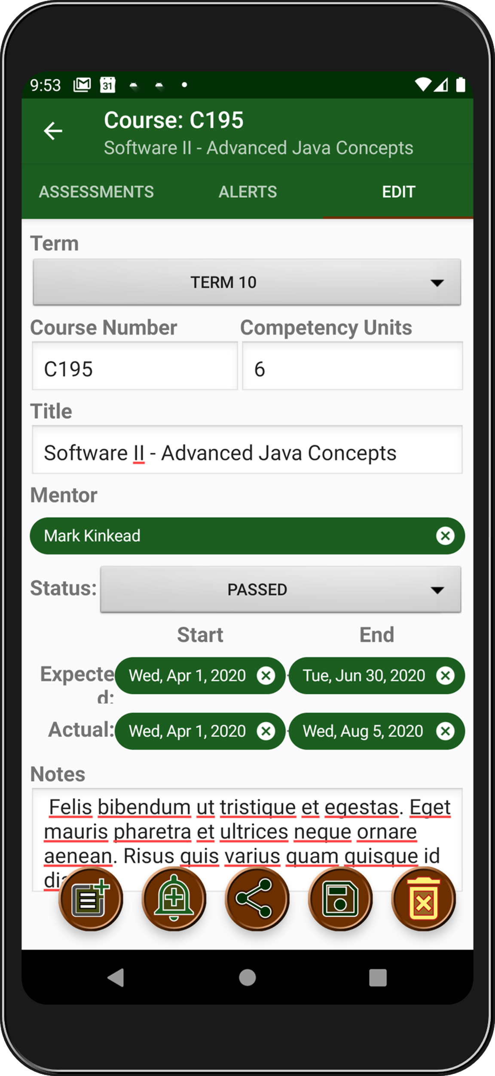

View Course Activity
Swipe right for alerts
Swipe right again to edit

Slide 10
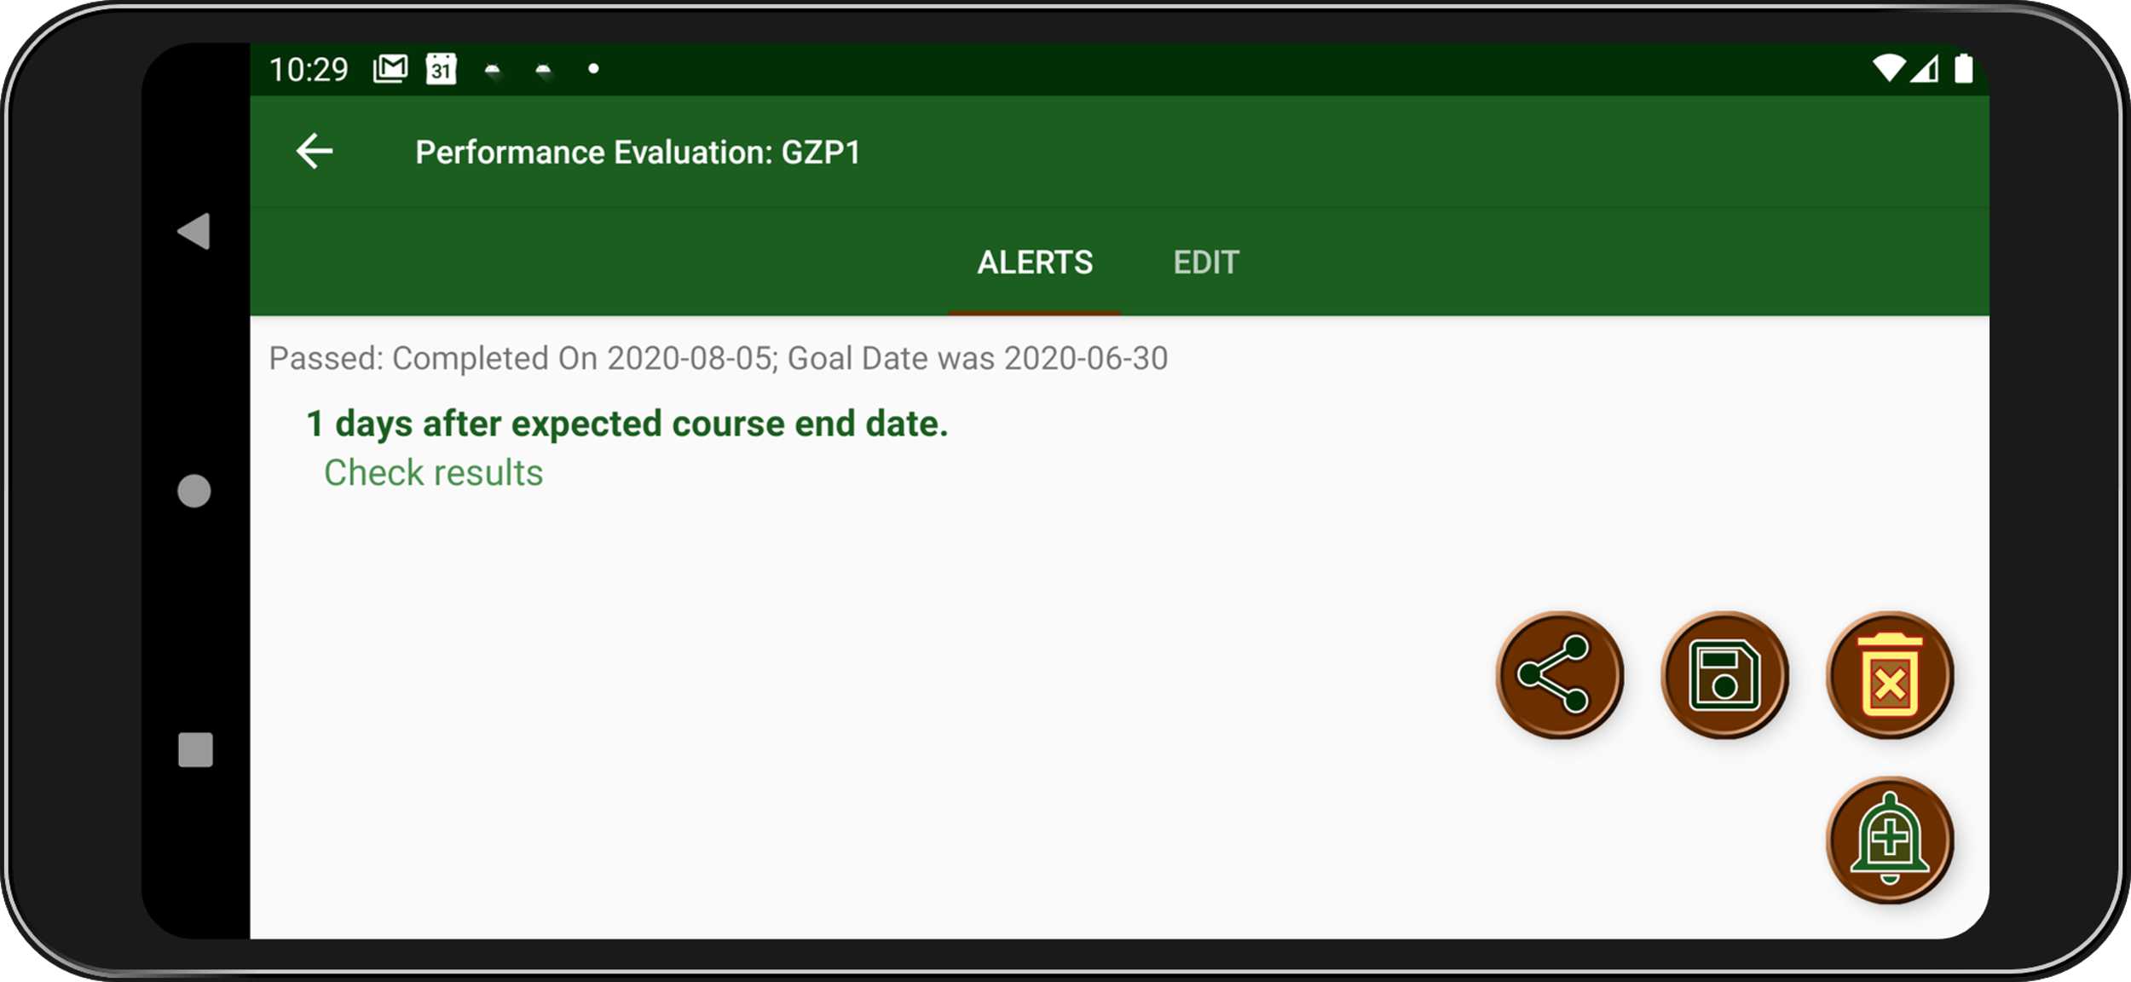
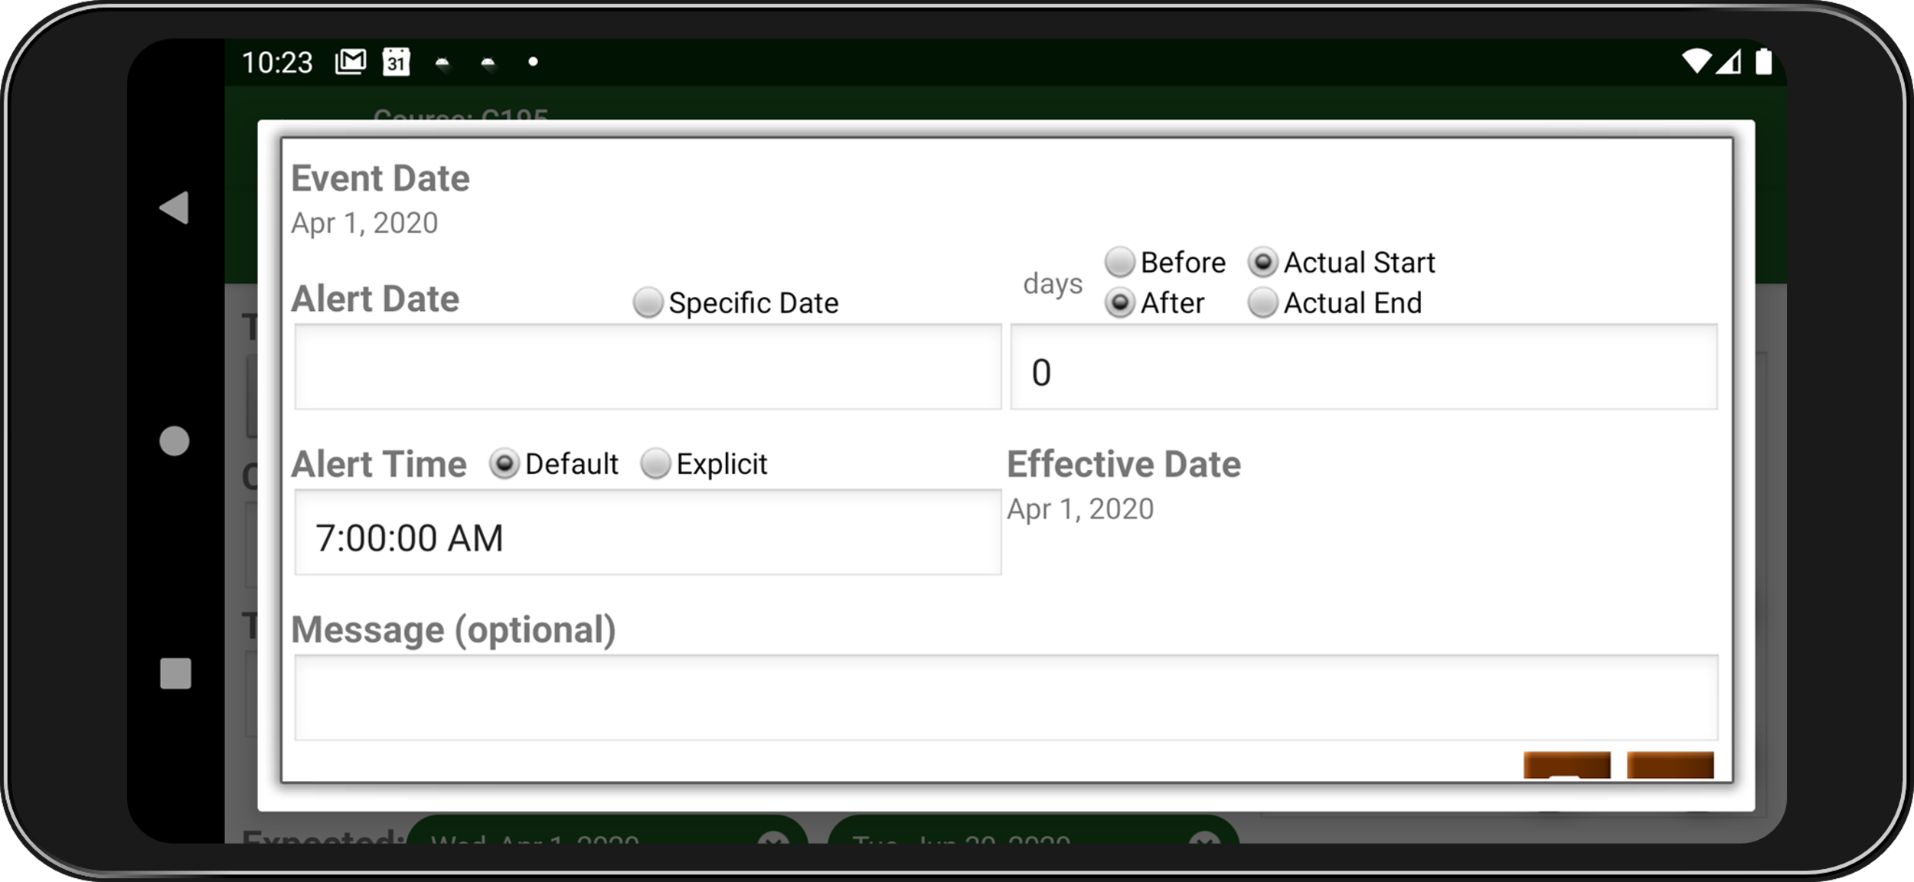
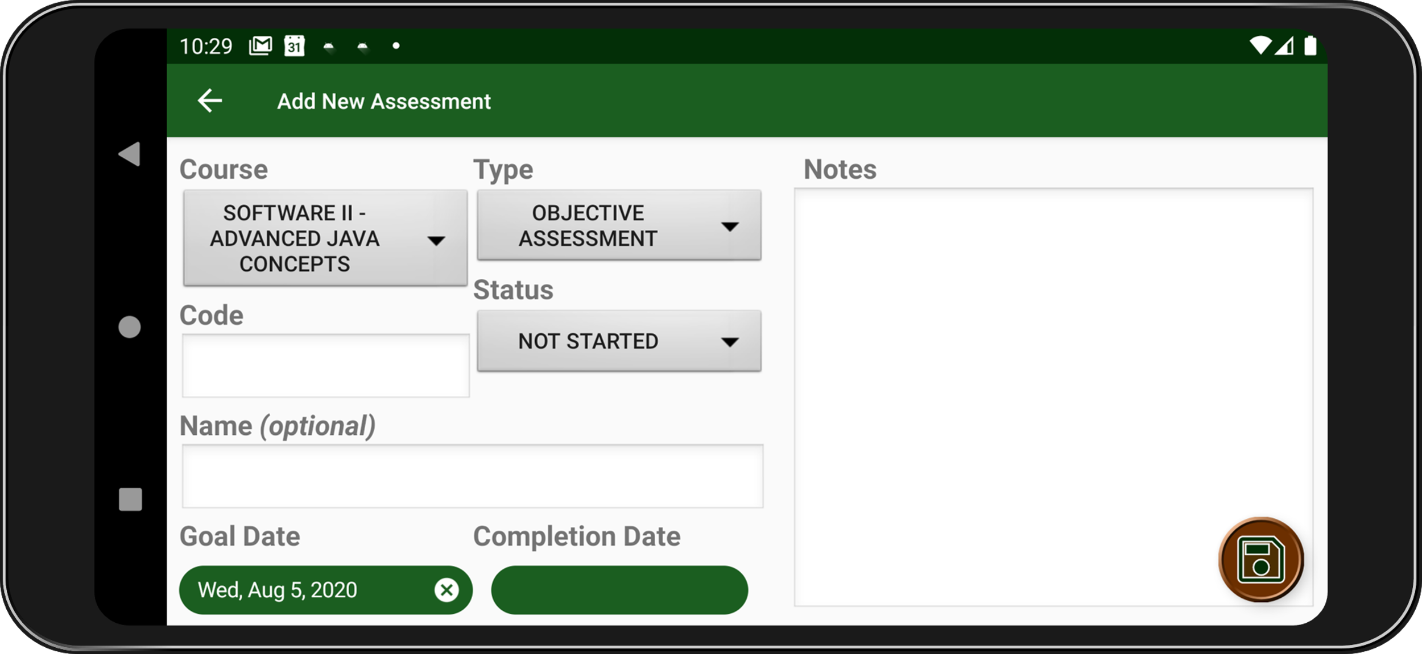
View Course Activity
View Assessment
Save Changes
View Assessment Activity
Share Course Info
Add Course Alert
Activity
Add Course Alert
Delete Course
Add Assessment Activity
Add New Assessment

Slide 11
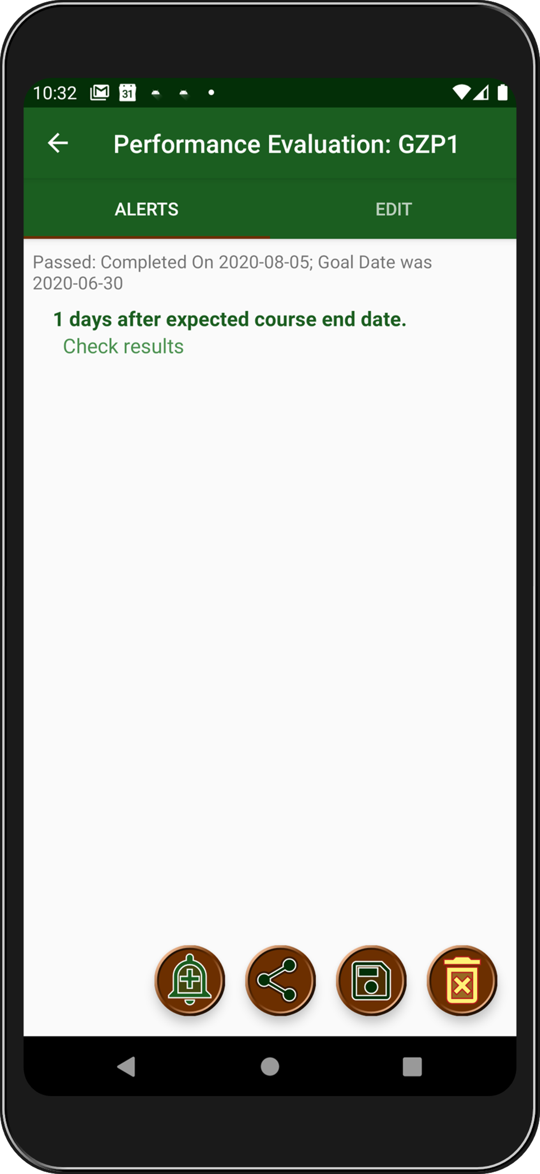
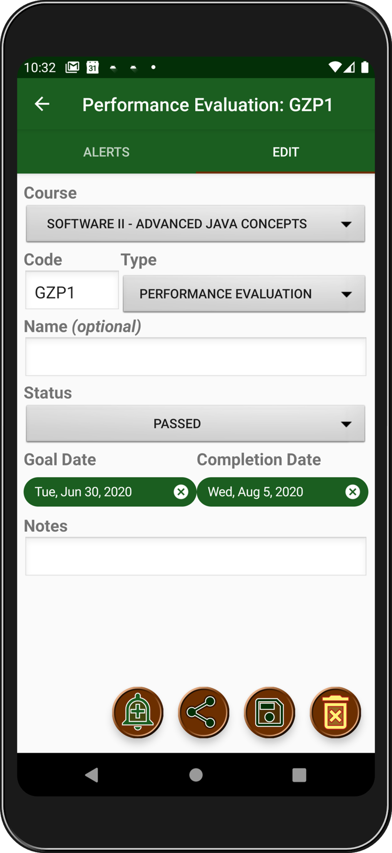
Swipe right to edit assessment
View Assessment
Activity
Swipe left for alert list

Slide 12
View Assessment
Activity
Edit Alert
Share Assessment Status
View Assessment
Alert Activity
Save Changes
Delete Assessment
Add Assessment
Aert Activity
New Assessment Alert

